Slide 1


Intelligent Electric Vehicle Charging and Battery Management System Using Reinforcement Learning
MLA03- REINFORCEMENT LEARNING
Presented By
E.V.Mahendra Reddy(192425214)
T.Ganesh(192425246)
Sri Vardhan(192425208)
Department & Institution
Department of Artificial Intelligence and Machine Learning
Saveetha School of Engineering
Project Details
Guide: Guide Name
Dr.G.A.Senthil

Slide 2
Abstract
This project presents an Intelligent Electric Vehicle Charging and Battery Management System using Reinforcement Learning.
The system dynamically optimizes EV charging based on electricity cost, grid load, station availability, waiting time, and battery health.
The Battery Management System continuously monitors SOC, SOH, temperature, voltage, and current to ensure safe charging.
The Reinforcement Learning agent learns optimal charging decisions to reduce cost, waiting time, battery degradation, and grid stress.
The proposed system improves battery lifespan, charging-station utilization, and overall efficiency of electric transportation.

Slide 3
Introduction
The increasing use of Electric Vehicles (EVs) creates a need for efficient and intelligent charging systems.
Traditional charging methods may cause high electricity costs, peak power demand, and inefficient battery usage.
A Battery Management System (BMS) monitors important parameters such as State of Charge (SoC), voltage, current, temperature, and battery health.
Reinforcement Learning (RL) can learn optimal charging and discharging strategies based on battery condition, energy demand, and electricity prices.
The proposed system aims to provide safe, cost-effective, energy-efficient charging while improving battery life and reducing grid load.

Slide 4
Objectives
01
Develop an intelligent EV charging management system.
02
Optimize charging schedules using Reinforcement Learning.
03
Predict battery health continuously.
04
Reduce electricity consumption and charging cost.
05
Increase battery lifespan.
06
Reduce waiting time at charging stations.
07
Improve charging station utilization.
08
Support sustainable and efficient electric transportation.

Slide 5
Problem Statement
Conventional EV charging systems often use fixed charging schedules, which may result in inefficient energy usage and increased charging costs.
Uncontrolled charging can create peak loads on the power grid, especially when many EVs are charged simultaneously.
Improper charging and discharging can cause battery degradation, reducing battery life and performance.
Existing systems may not dynamically consider battery condition, electricity demand, charging time, and energy prices.
Therefore, an intelligent EV charging and battery management system using Reinforcement Learning is needed to optimize charging, reduce costs, protect battery health, and improve overall energy efficiency.

Slide 6
LITERATURE REVIEW
Year | Authors | Research Work | Method / Algorithm | Key Findings | Limitation / Research Gap
2023 | Research on EV charging management with V2G and battery degradation | Deep Reinforcement Learning | DRL with V2G | Considered conventional and fast charging, V2G, user requirements, charging cost and battery degradation while handling uncertainty. | More comprehensive than basic charging models, but practical large-scale deployment and real-time multi-station coordination remain challenging.
2024 | Zhonghao Zhao, Carman K. M. Lee, Xiaoyuan Yan, Haonan Wang | Reinforcement Learning for Electric Vehicle Charging Scheduling: A Systematic Review | Systematic Review of RL | Reviewed 111 relevant articles and analyzed RL approaches according to objectives, state space, action space, algorithms and training strategies. | Identifies major research gaps including scalability, uncertainty, training efficiency and practical deployment.
2025 | Panagiotis Michailidis, Iakovos Michailidis, Elias Kosmatopoulos | Reinforcement Learning for Electric Vehicle Charging Management: Theory and Applications | RL / DRL Review | Provides a structured review of RL for EV charging-station control, including value-based, policy-based, actor-critic, single-agent and multi-agent approaches.

Slide 7
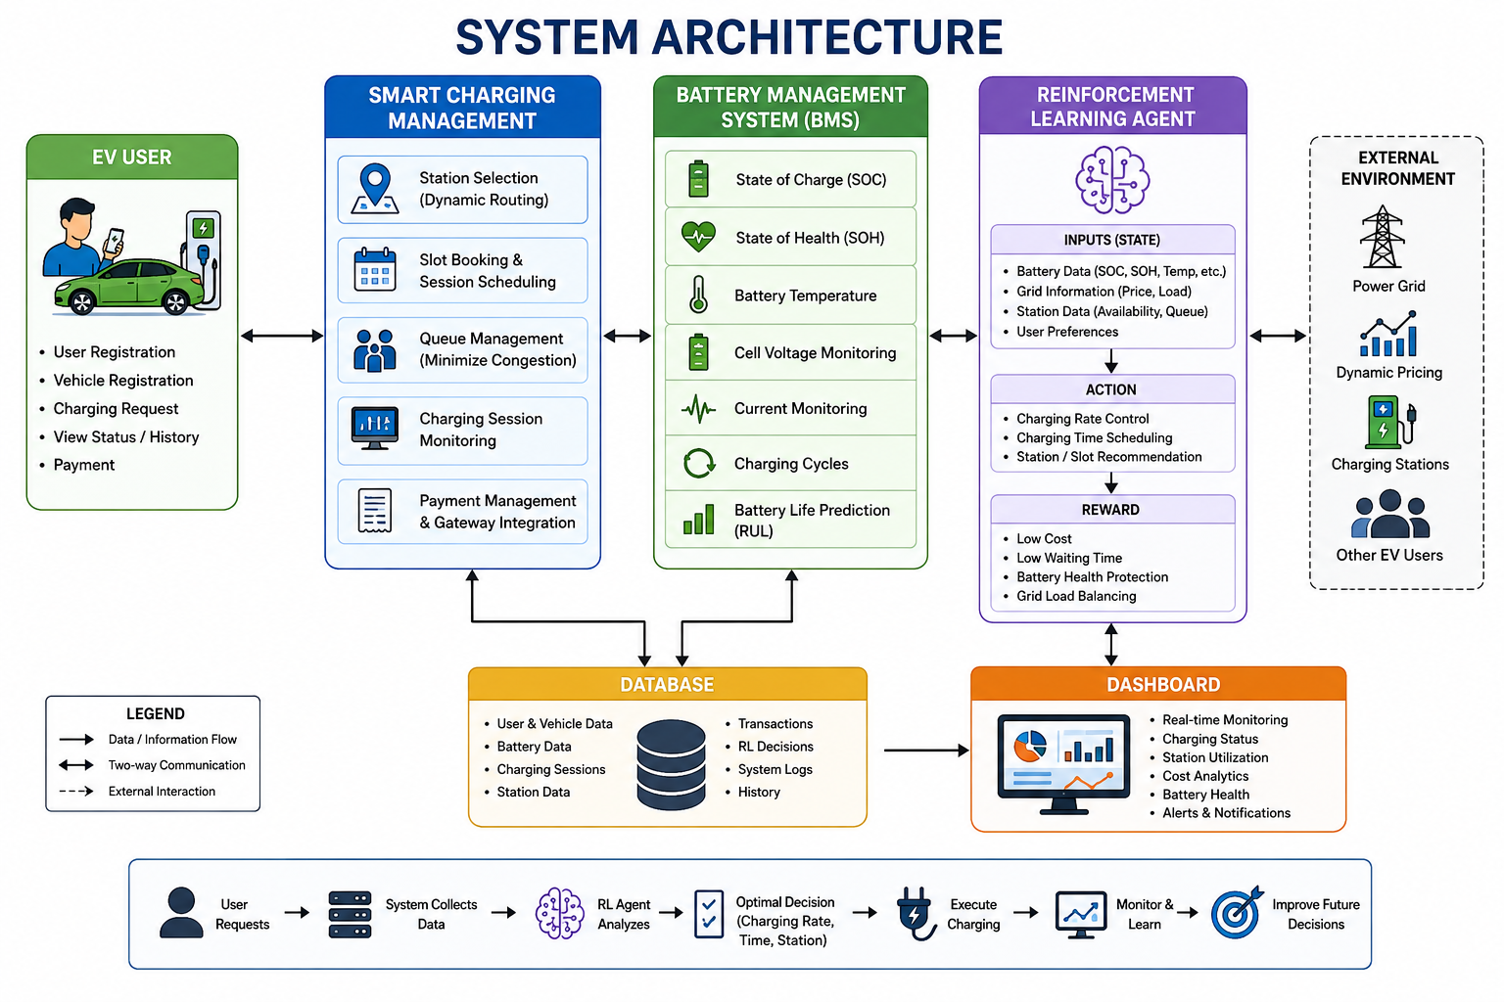
SYSTEM ARCHITECTURE

Slide 8
Module 1
Smart EV Charging Management
Develop an intelligent system to control and optimize EV charging based on battery status and charging requirements.
Monitor parameters such as State of Charge (SoC), charging current, voltage, and power consumption.
Use Reinforcement Learning (RL) to determine the optimal charging time and power level.
Reduce peak electricity demand and charging costs by scheduling charging during suitable periods.
Ensure efficient and safe charging while minimizing unnecessary battery degradation.

Slide 9
Module 2
Intelligent Battery Management
Monitor important battery parameters such as State of Charge (SoC), State of Health (SoH), voltage, current, and temperature.
Use intelligent algorithms to estimate battery condition and predict battery performance.
Apply Reinforcement Learning (RL) to optimize battery charging and discharging decisions.
Prevent overcharging, deep discharge, overheating, and excessive battery stress.
Improve battery lifespan, safety, reliability, and overall energy efficiency.

Slide 10
Module 3
Reinforcement Learning Optimization
Develop an RL-based decision-making model to optimize EV charging and battery management.
Define the state, actions, and reward function based on battery condition, charging demand, energy price, and grid load.
Train the RL agent to select the optimal charging or discharging strategy.
Minimize charging cost, peak power demand, and battery degradation through continuous learning.
Improve overall energy efficiency, battery performance, and charging reliability.

Slide 11
Software Requirements
Technology | Purpose
Python | Main programming language for developing the system and implementing the RL model
Reinforcement Learning | Optimizes EV charging decisions based on real-time conditions
Q-Learning | Handles discrete charging states and actions
Deep Q-Network (DQN) | Handles complex, multi-dimensional charging and battery data
Battery Management System (BMS) | Monitors SOC, SOH, temperature, voltage, current, and charging cycles
Database | Stores user, vehicle, battery, charging, and system information
Dashboard | Displays real-time charging status, battery health, cost, and station information
IoT / Sensors | Collects real-time battery and charging parameters

Slide 12
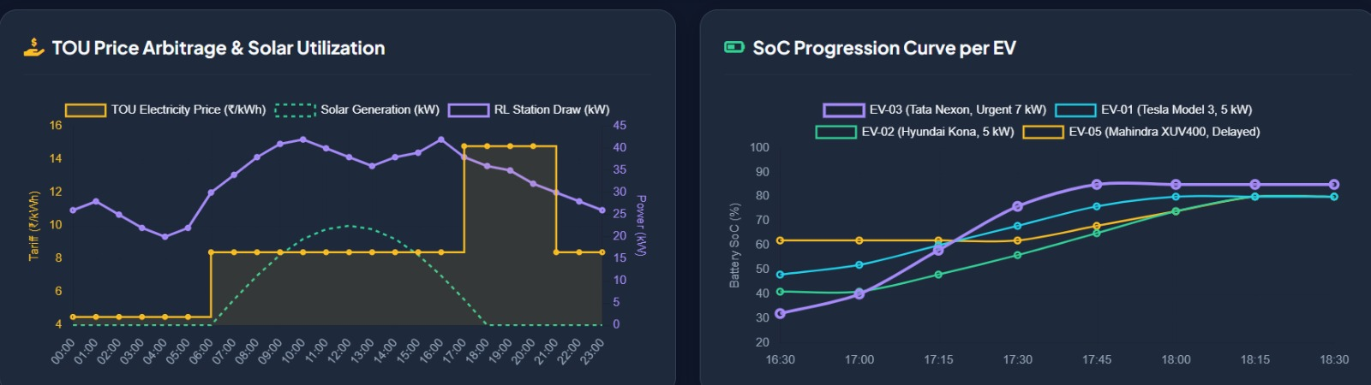
Results and Discussion
Reduced charging cost by selecting suitable charging periods based on electricity tariffs.
Reduced waiting time through intelligent charging-station and queue management.
Improved battery protection by monitoring SOC, SOH, temperature, voltage, and current.
Improved charging-station utilization by distributing charging requests efficiently.

Slide 13
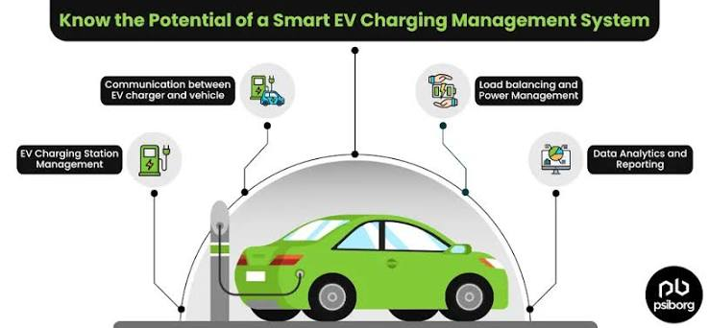
Conclusion
The proposed Intelligent EV Charging and Battery Management System using Reinforcement Learning provides an adaptive solution for efficient EV charging.
The system combines Smart Charging Management, Battery Management, and Reinforcement Learning to make intelligent charging decisions.
Continuous monitoring of SOC, SOH, temperature, voltage, current, and charging cycles helps maintain battery safety and health.

Slide 14
Thank you

